Slide 1

Oil: Social, environmental and economic concerns
Francesco Gardumi
gardumi@kth.se
Introductory lecture – Energy commodities and technologies
This work by OpTIMUS.community is licensed under the Creative Commons Attribution 4.0 International License. To view a copy of this license, visit http://creativecommons.org/licenses/by/4.0/.

Slide 2
Commodity: global trends
Demand
Supply
Resources

Slide 3
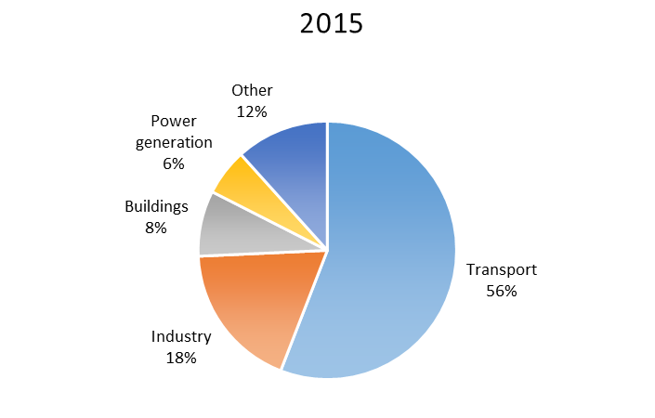
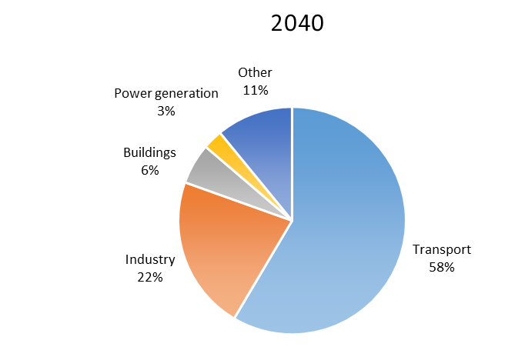
Demand
Total: 92.5 mb/d
Total: 103.5 mb/d
Source: IEA World Energy Outlook 2016.

Slide 4
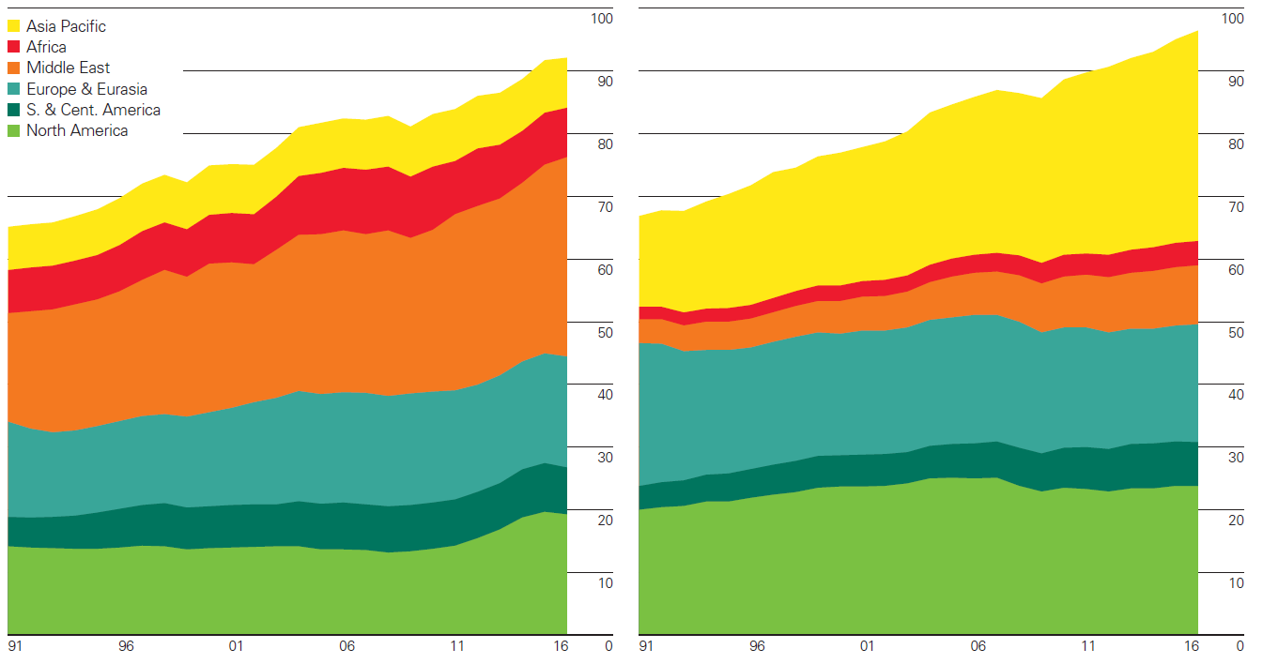
Supply
Oil production (mb/d) Oil consumption (mb/d)
Source: BP Statistical review of World Energy 2017.

Slide 5
Resources
Conventional resources:
Crude oil
NGLs (Natural Gas Liquids): including heavier molecules than Methane, like Ethane, Propane, Butanes, Pentanes…
Unconventional resources:
EHOB (Extra-Heavy Oil and Bitumen): aka oil sands. Highly dense and viscous crude oil trapped in unconsolidated sandstone. Main deposits: Alberta (Canada) and Orinoco (Venezuela).
Kerogen oil: aka oil shale. Produced from fine-grained sedimentary rock containing kerogen (solid mixture of organic compounds). Main producer in 2009: Estonia.
Tight oil: light crude oil contained in petroleum-bearing formations of low permeability. Produced by hydraulic fracturing of the rocks (similar process as for shale gas). Main reserves: Russia, US, China, Argentina, Libya, Venezuela. Currently developed in US and Canada.

Slide 6
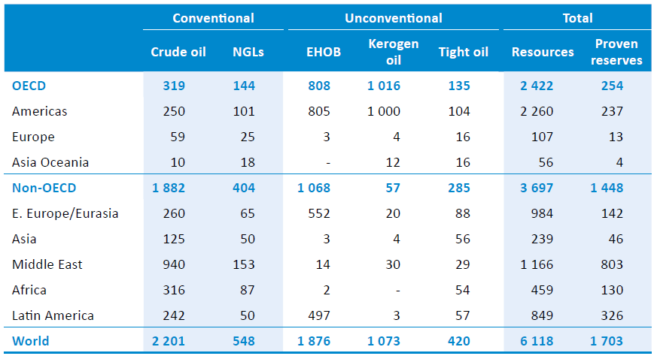
Resources
Proven reserves = 90% probability to be extracted profitably
Reserves to Production ratio (R/P) of around 40 years
Oil resources (billion barrels)
Source: IEA World Energy Outlook 2016.
Notes:
These figures haven’t changed significantly since IEA World Energy Outlook 2015.
The reserves to production ratio (R/P) represents the length of time that proven reserves would last if production was to continue at current rates.

Slide 7
Technologies in the oil chain
Extraction
Transportation and storage
Refinery
Combustion-based power plants
Economic, Environmental and Social concerns

Slide 8
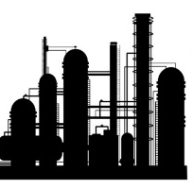
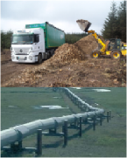
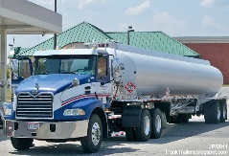

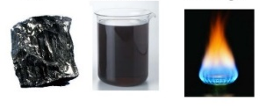


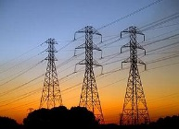


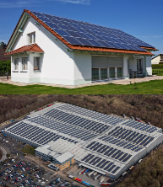
Sample Reference Energy System
Import / Extraction+processing of fossil fuels
Fuel transportation
Refinery
Transportation of oil products
Energy demand
Transportation sector
Oil
Oil
Oil products
Combustion-based
power plant
Energy demand
Residential sector
Electricity
Electricity transmission and distribution
Energy demand
Commercial sector
Energy demand
Industrial sector
Decentralised energy supply
Heat

Slide 9
Extraction
Processes - conventional oil:
Conventional wells: lately case drilling is used
Deepwater production: made possible by floating platforms. 3000 m reached in 2005.
Enhanced Oil Recovery (EOR): CO2, N2 or CH4 injected to displace and replace oil.
Processes - unconventional oil:
Cycle Steam Simulator (CSS): steam injected in the well to allow oil to flow. Used with Extra Heavy Oil.
Steam Assisted Gravity Drainage (SAGD): similar to CSS, but oil is allow to drop onto a lower horizontal collector by gravity.
Retorting: heating in the absence of Oxygen.
Key characteristics
Conventional oil
Capital cost | 5.3-63.7 $/boe
VOM cost | 3.2-8.3 $/boe
Recovery factor | 30-50%
Energy use | 0.8-2.3 GJ/toe
CO2 Em. factor | 64.9-273.6 ton/ktoe
Unconventional oil
Capital cost | -
VOM cost | 6.6-19.7 $/GJ
Recovery factor | 10-70%
Energy use | 20-30% of produced
CO2 Em. factor | 9.3-15 gCO2/MJ
Notes:
Case drilling: after the well is drilled, a diameter casing is inserted and fixed with cement (one of the things which failed in deep water horizon).
Deepwater production: 70% of the deepwater potential is among 2000 and 4000 m.
Steam Assisted Gravity Drainage: steam injected in the well to make the oil flow and this falls for gravity into a lower horizontal collector.
Retorting: heating up to 500 C.
Capital cost for conventional: it is the exploration and development cost. Middle East onshore is the lower bound, US offshore is the upper one. Decommissioning cost not included, it depends much on the type of installation and decommissioning.
The VOM cost is the production cost.
Energy use: it consists in using local produced gas or other external supplies (electricity, gas, oil) to feed the facility.
CO2 emission factor for conventional: Europe is the lower bound, Africa is the upper.
CO2 emission factor for unconventional: upper bound is for oil shale.
The emission factor does not include the flared and vented natural gas, which is a major environmental concern. For conventional oil, 150 Mm3 year worlwide, in 2005.
The recovery factor is another parameter defined specifically for extraction processes. It contributes to the definition of the efficiency.

Slide 10
Transportation and storage
Key characteristics
Oil tankers
Capital cost | 48-151 M$
Fuel consumption | 2.2-3.8 g diesel/ton-km
Lifetime | 29 years
CO2 Em. factor | 3.8-6.6 gCO2/ton-km
Pipelines
Capital cost | 2.3 M$ / km
Energy use | 0.5% of transported
Lifetime | 25-40 years
CO2 Em. factor | -
Oil tankers
Usually for international transportation of crude oil.
Pipelines
Usually for domestic transportation to refinery sites. Equipped with pumping stations.
Trucks and railway
For short-distance transportation of limited quantities from small wells to refineries.
Storage
In shallow or underground tanks, or oil tankers. For market (prices) or security reasons.

Slide 11
Refinery
Key characteristics
Capital cost | 31 k$ / barrel – day
O&M cost | 3-4 $ / barrel
Efficiency | 90%
Energy use | Increasing 61 MJ/m3 crude oil feedstock per additional 1 kg/m3 sulphur
CO2 Em. factor | 47.4 kg CO2/barrel Can increase 40% with low quality crude
Capacity factor | 83-93%
Basic process consists in atmospheric + vacuum distillation. Refineries can be categorised based on complexity:
Topping: basic processes.
Hydro-skimming: in addition to basic processes, they include hydrotreating and reforming units for light compounds.
Conversion: compared to hydro-skimming they also include catalytic cracking and hydrocracking for heavier oils.
Deep-conversion: like conversion refineries, with addition of coking units for the heaviest oil fractions.
Notes:
Important to consider that actually there exist almost as many processes as the refineries around. E.g. as many as 50 different processes can be used in large and complex refineries. The values in the table are average values collected by IEA-ETSAP, not differentiated by type of refinery, and in most cases referring to US refineries.

Slide 12
Combustion-based power plants
Key characteristics
HFO Gas Turbines
Capital cost | 1490 $/kW
Efficiency | 35%
Diesel generators
Capital cost | 780 $/kW
FOM cost | 8 $/kW/a
Efficiency | 35%
Utility scale power generation from oil products like heavy fuel oil or diesel has been phasing out and has now a minor share. Small diesel generators are still used as backup (e.g. in hospitals, factories or households), especially in developing countries.
Traditionally, oil products were used for instance in:
Heavy Fuel Oil-fired gas turbines;
Utility scale diesel generators.

Slide 13
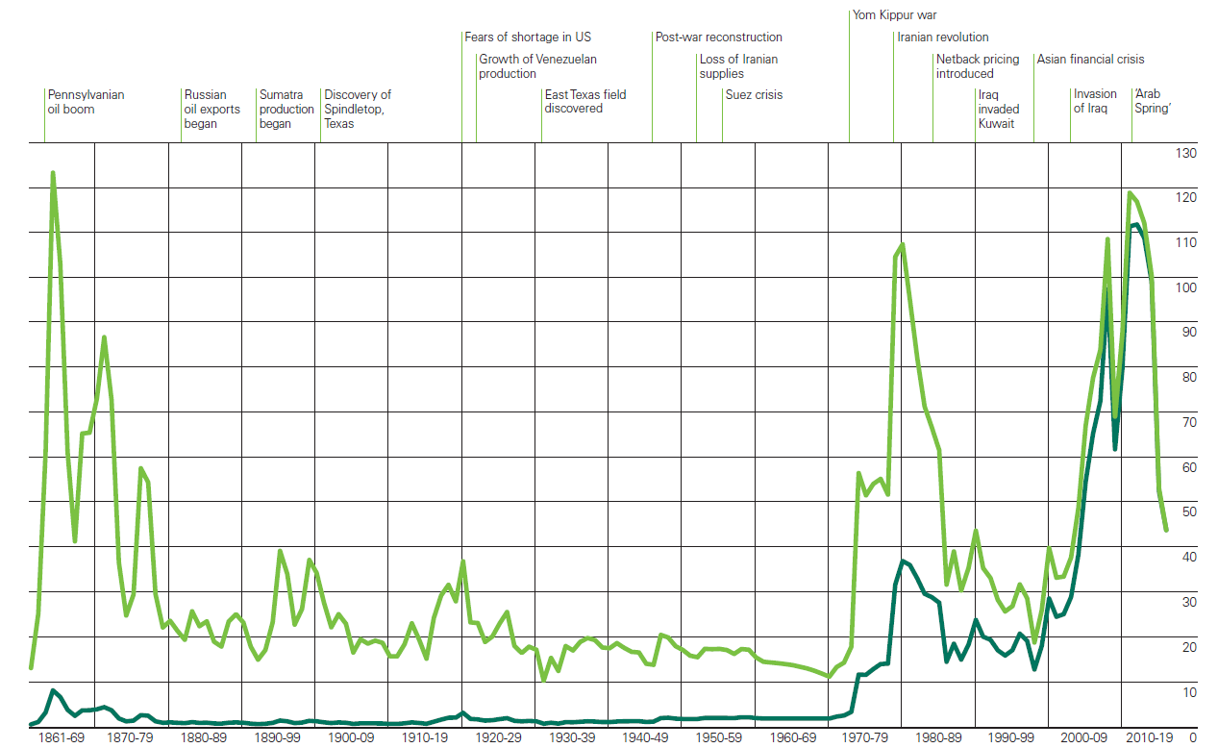
Economic concerns
Given the oscillation of the oil prices, it is important to have:
Moderated Import dependency: portion of primary energy imported from other countries;
High Diversity of the energy mix: 1) in the resources and 2) in the suppliers
Source: BP Statistical review of World Energy 2017.

Slide 14
Environmental concerns
Hydraulic fracturing (fracking). Well-stimulation technique used for tight oil. Consists in fracturing rocks with pressurized liquid, containing water, proppants and thickening agents. Once fractures are created to extract oil or gas, the proppants hold the fractures open. Concerns regarding:
Waste-water disposal
Pollution of underground water
Increased seismic activity (e.g. Canada, Montney’s formation)
No full transparency about chemicals used in the pressurized mixture
Extraction of oil sands. Water-consuming process. It is sometimes limited through water recycling.
Gas flaring in production sites. Residual natural gas extracted with oil is burnt, causing CO2 and pollutants emissions and waste of resources.

Slide 15
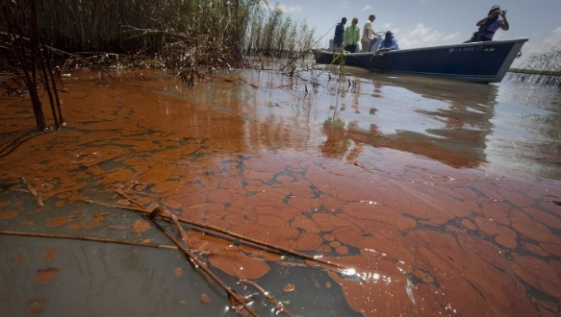
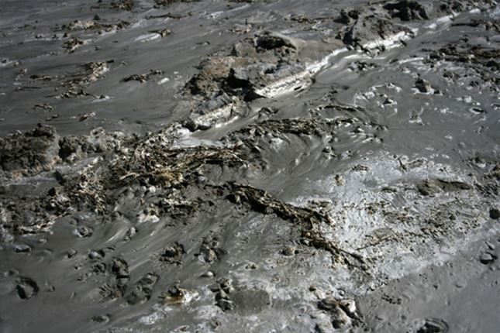
Environmental concerns
High number of oil spills due to accidents
BP oil rig Deepwater Horizon, US - Gulf of Mexico, 2010. Estimated 500-600 thousands tonnes oil spilled
The 5 largest oil spills in history (Source: The Telegraph)
What? | When and where? | How much? (Mgallons)
Gulf war | 1991, Kuwait | 240-336
Deepw. Horizon | 2010, Mex. gulf | 210
Ixtoc 1 Oil Well | 1979, Mexico | 140
Atlantic Empress | 1979, Trinidad | 88
Fergana Valley | 1992, Uzbekistan | 88
Mingbulak oil field, Fergana Valley, Uzbekistan, 1992. Estimated 285 thousands tonnes oil spilled

Slide 16
Environmental concerns
Direct and indirect emissions of CO2 and pollutants.
Emissions from combustion of Hydrocarbons have effects at different scales: global, regional and local.
CO2: GHG with effect at global scale;
NOx and SOx: effects at regional scale (acid rains and human health impacts) and global scale (destruction of stratospheric ozone layer);
PM (Particulate Matter): effects mainly at local scale;
CO: effects mainly at local scale (intoxication, deathly at high concentrations).

Slide 17
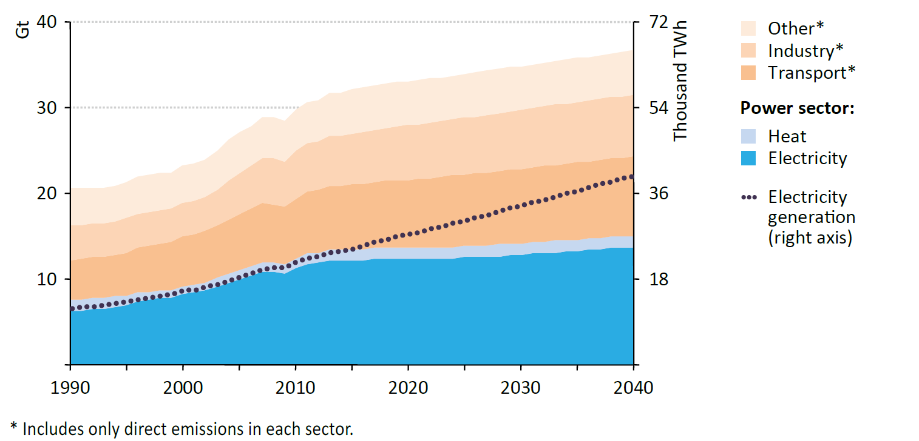
Environmental concerns
Direct and indirect emissions of CO2 and pollutants.
Global CO2 emissions by sector (direct).
Oil products-based transport sector accounts for second biggest share in global CO2 emissions.
But we saw in the description of the oil supply chain that there are emissions along the whole chain!
Source: IEA, World Energy Outlook 2015, New Policies Scenario.

Slide 18
Social concerns
Oil often imported from politically unstable regions, where sometimes wars, civil conflicts or turmoil in act (see e.g. Nigeria, Iraq, etc.)
Oil production activities from foreign companies do not necessarily help reduce the militarisation of some regions
Reported cases of big displacement of population for oil extraction activities: Nigeria, Sudan, Ecuador, Colombia.
Oil spills also harm local societies and activities: e.g. spill of Deepwater Horizon affected the fishing activities of communities along the coast.

Slide 19
Conclusions

Slide 20
There is high demand for oil in all sectors, which is not expected to decrease;
Until it doesn’t, production of conventional and unconventional oil is expected to continue, with economic, environmental and social constraints;
The transportation sector drives large part of the demand. Electrification of this sector could contribute largely to a drop in the production.
Notes:
Let’s do an exercise: the technologies in the oil supply chain (as those in the others) are judged based on the characteristics you saw (capital cost, O&M cost, efficiency, energy use, emission factor). We saw that the oil supply chain has a few ’externalities’, i.e. indirect costs paid by no one but the environment and societies. How do you think we could ’internalize’ those costs?

Slide 21
References and reading material

Slide 22
IEA, World Energy Outlook 2016;
British Petroleum, Statistical Review of World Energy 2017. Available at: https://www.bp.com/content/dam/bp/en/corporate/pdf/energy-economics/statistical-review-2017/bp-statistical-review-of-world-energy-2017-full-report.pdf;
IEA-ETSAP, Energy Technology Data Source. Available at: https://iea-etsap.org/index.php/energy-technology-data;
How natural gas could be a geopolitical game-changer in the Mideast: https://www.youtube.com/watch?v=pay5dKYvXGU
Profit Pollution and Deception BP and the Oil Spill: https://www.youtube.com/watch?v=8zGFvzMMO9w&t=706s

Slide 23
Sources for the pictures
Gasification: http://www.gbgasifired.com/model.html
Extraction: http://www.energytrendsinsider.com/research/coal/coal-mining-and-processing/
Refinery: http://stillwaterassociates.com/crack-spread-a-quick-and-dirty-indicator-of-refining-profitability/
Biomass: http://inhabitat.com/tag/biomass/
Renewables: http://www.topnews.in/wind-water-and-sun-beat-biofuels-nuclear-and-coal-clean-energy-297577
Uranium: http://unitednuclear.com/index.php?main_page=product_info&products_id=1028
Fossil: https://www.slideshare.net/MMoiraWhitehouse/fossil-fuels-teach
Combustion based power plants: https://en.wikipedia.org/wiki/Battersea_Power_Station_in_popular_culture
Uranium enrichment: http://energyfromthorium.com/2010/08/06/loveswu1/

Slide 24
Sources for the pictures
Residential: http://jhsimpson.com/residential/
Transport: https://se.123rf.com/clipart-vektorer/transport.html
Industry: http://indianexpress.com/article/business/economy/factory-output-grows-2-per-cent-in-february-after-3-months-of-contraction/
Commercial: http://www.alfalaval.com/industries/refrigeration/commercial-refrigeration/
Transportation of fuel: http://www.zerohedge.com/news/2017-06-23/demand-oil-pipeline-capacity-hits-6-year-low
Transportation of biomass: http://www.forestenergy.ie/transportation-studies.php
Transportation of oil products: http://www.picquery.com/gasoline-truck_WXRZaplkZ2eaRVifu*zjqPAvrMnnxmBsTSgdn*BBBKk/
Decentralized energy supply: http://trayamtechnologies.com/solar-pv-roof-top-and-ground-mounting/
Decentralized energy supply2: http://www.sunwindenergy.com/photovoltaics/38-mw-rooftop-pv-system-completed-uk

Slide 25
Changelog and attribution
Date | Author | Reviewer | Reviser
2017-09-23 | Francesco Gardumi | Francesco Fuso Nerini | Francesco Gardumi
To correctly reference this work, please use the following:
Gardumi, F., 2017. Oil: Social, environmental and economic concerns, OpTIMUS.community. Available at: http://www.osemosys.org/understanding-the-energy-system.html. [Access date]

